Slide 1


Customise data that works for you
Compare performance to other businesses
Plan with confidence rooted in up-to-date data

Slide 2
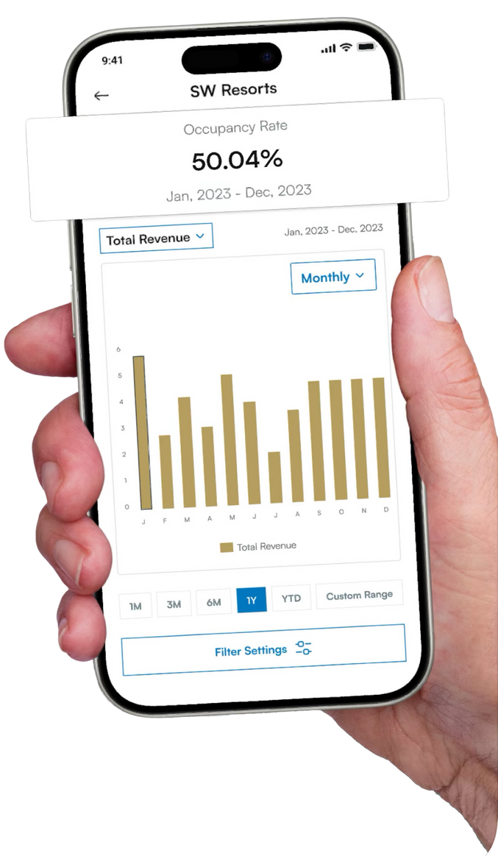

swvehub.co.uk
The South West Visitor Economy Hub (SWVEH) is a new online information system tracking the performance of the tourism sector in Devon and Somerset.
It provides businesses and organisations with the data they need to grow, like never before.
Business can compare performances with their peers and plan their activity around reliable, real-time information.
All organisations can access real-time intelligence - from visitor arrivals, profile and perceptions, to expenditure, economic impact, and forward-looking data.
It’s already becoming a ‘must-have’ for all tourism businesses and organisations in Devon and Somerset, as well as investors and other interested parties.

Slide 3
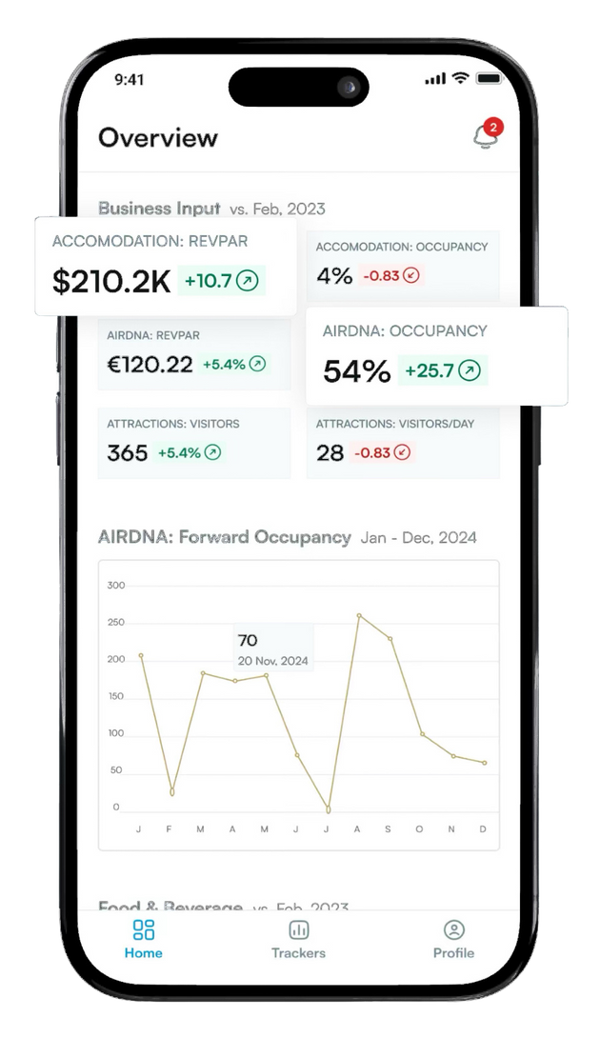








Key Benefits
Visitor demographics: Who is visiting Devon and Somerset?
Visitor volume: How many tourists are traveling to the area?
Visitor feedback: What do visitors think about the area?
Perceptions: Why are some people not visiting?
Economic impact: What is the economic impact of tourism?
Future trends: What does the future hold for the tourism sector?
Digital marketing: What is the impact of digital marketing efforts?
Business performance: How is your business performing compared to peers?
Influences on performance: What factors are affecting business performance?

Slide 4
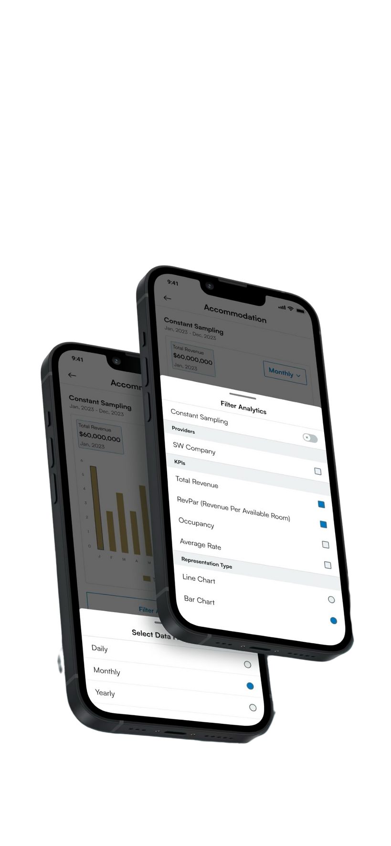
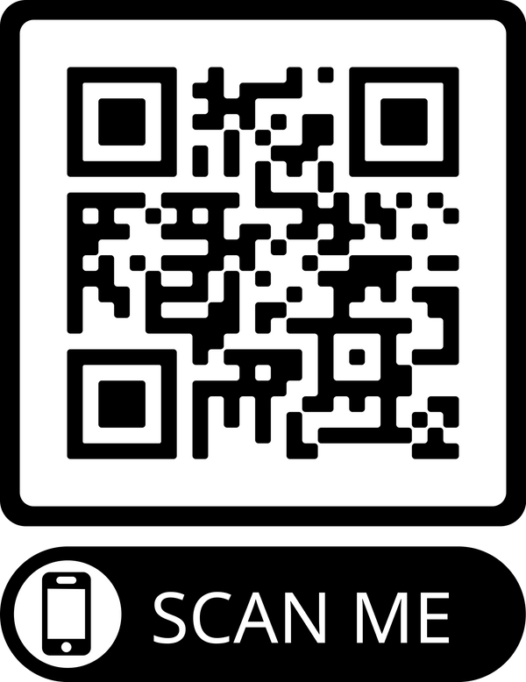
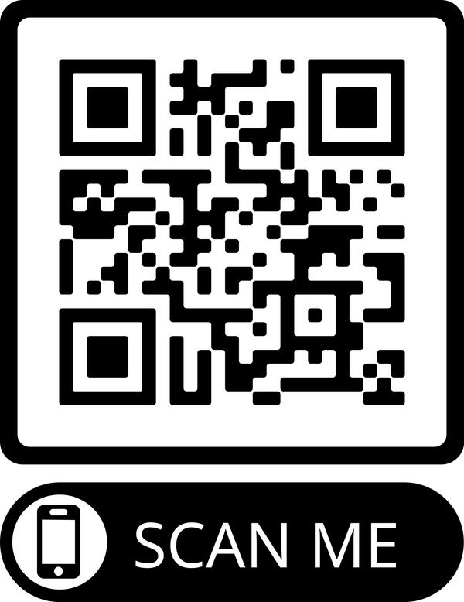
Sign-up
The Hub is free to access for visitor economy businesses.
Other organisations and businesses will soon be able to pay to access.
Sign-up is simple, go to swvehub.co.uk for details
Visit the website
Download the App

